Slide 1
Branch Network Induction
Introducing
Nationwide Group Staff Union

Slide 2
About NGSU
Independent TUC Affiliated Trade Union
NGSU is a ‘staff’ union
Around 12,000 members
50 years within NBS
No political affiliation or donations
Dedicated to Protecting Members’ Interests
Negotiating Terms and Conditions
Help and Advice at Work
Individual Representation
Benefits and Discounts

Slide 3
Working with the Branch Network
Independent Advice At Work
We provide an independent view about employment issues to our members. We also help and support individual members with any problems they may encounter at work
Including:
Pay & Benefits
Terms & Conditions
Performance
Disciplinary & Grievance
End of Probation Review
Change Programmes

Slide 4
Working with the Branch Network
See what your Director says about NGSU…
“I value our relationship with the Staff Union and recognise the benefits of working together and the support the Union provides to individual employees.
I also support and encourage Union members to become Union Representatives and help us understand the issues impacting on our teams and shaping the way we work.”
Mandy Beech Member Experience Director

Slide 5
What Have The Unions Ever Done For Us?

Slide 6
What Has NGSU Done For Us?
We have worked to negotiate improved rights for employees, including…
Best pay awards in the FS Sector (IDS)
Equal pay
Enhanced maternity & paternity benefits
Flexible working and flexible retirement
Pension scheme
Redeployment and severance terms

Slide 7
What Has NGSU Done For Us?
Some Practical Examples
 | Legal Requirement | Nationwide Min
Pay (Hourly) (from 1/4/22) | Over 23 £9.50 21 – 22 £9.18 18 – 20 £6.83
Holiday | 28 days, including public holidays
Sick Pay | From day 4 of sickness, £96/week, for 28 weeks
Maternity Pay | 90% of your weekly earnings, for 6 weeks, then £151.97/week, for 33 weeks

Slide 8
What Has NGSU Done For Us?
Some Practical Examples
 | Legal Requirement | Nationwide Min
Pay (Hourly) (from 1/4/22) | Over 23 £9.50 21 – 22 £9.18 18 – 20 £6.83 | £10.49 (June 22) (£11.51 for MRs)
Holiday | 28 days, including public holidays | 25 days, plus public holidays
Sick Pay | From day 4 of sickness, £96/week, for 28 weeks | In first 6 months of employment, 2 months’ full pay in 6 months After 6 months’ employment, 6 months’ full pay in 12 months All from 1st day of sickness
Maternity Pay | 90% of your weekly earnings, for 6 weeks, then £151.97/week, for 33 weeks | 100% of weekly earnings, for 26 weeks, then £151.97/week, for 13 weeks

Slide 9
Monthly Susbcription Draw
Available To Members Only…
First Prize Of Up To £15,000
Second Prize Of £5,000
Third Prize Of £2,000
Plus Other Prizes
£1 Per Chance, Maximum 10 Chances
Join The Union, And You Could Win!
Total Winnings in 2021:
£275,258!

Slide 10
Join Us Today – Together We Are Stronger
Monthly Subscription Fee - from 1st April 2020
Full Time Staff £11.90 p/m
Part Time Staff (16+ hours) £6.30 p/m
Part Time Staff (-16 hours) £4.80 p/m
Maternity & Pensioners £2.55 p/m
How do we compare? - @ Dec 2020
Unite = £16.25 F/T p/m £9.45 P/T p/m
GMB = £14.57 F/T p/m £8.40 P/T p/m
Unison = up to £22.50* p/m
*Linked to salary – rates shown based on equivalent salaries in NBS.

Slide 11
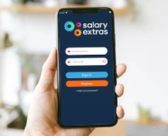
Member Benefits - Discounts
NGSU Extras
NGSU Extras is designed to help you make the most of your membership by providing a great package of savings with some of the best names on the high street and other fantastic offers
Discounted Cinema Tickets
Discounted Gym Membership
Discounted Theme Park Tickets
Reductions on EE Phone Plans
Instant Discounts including Just Eat and Deliveroo
now available via an App so you always have access!

Slide 12
NGSU Extras
Adidas | 9% | Harvester | 10% | Primark | 5%
All Bar One | 10% | Google Play | 4% | River Island | 6%
Argos | 5% | H&M | 5% | Sainsbury’s | 3%
Asda | 3% | H Samuel | 5.5% | Spotify UK | 5%
Ask Italian | 7% | Halfords | 7% | Starbucks | 10%
ASOS | 7% | Home Sense | 6% | Swarovski UK | 15%
B&Q | 4% | Iceland | 3% | TK Maxx | 8%
Beer 52 | 15% | Just Eat UK | 6% | Ted Baker | 9%
Boohoo | 4% | Laithwaite’s Wine | 10% | Tesco | 3%
British Pub Cards | 8%-10% | M&S | 5.5% | The Entertainer | 3%
Clarks | 8% | Mango | 3% | The White Company | 9%
Costa | 7% | Morrisons | 3.5% | Uber Eats | 3%
Currys PC world | 5.5% | New Look | 8% | Wagamama | 8%
Deliveroo | 2.5% | Nike | 5% | Zizzi | 7%
Foot locker | 9% | Pizza Hut | 8% | Aldi*** | 2.5%
Discounts correct as at 1 September 2022, and are subject to change
*** e-gift card needs to be printed & given to cashier

Slide 13
Additional Member Discounts
Hotpoint Privilege Purchase Club
Exclusive to NGSU offer savings of up to 30%. Introducing, the Hotpoint Privilege Purchase Club, offering exclusive pricing on Hotpoint, Whirlpool and Indesit products – over 850 different appliances.
Virgin Experience Days
We have teamed up with Virgin Experience Days to offer you an exclusive 15% discount on all full priced experiences.

Slide 14
Additional Member Discounts
Insurance Commission Rebate Scheme
IFS Wealth & Pensions (IFSWP) is an entirely independent company able to offer a Premium Comparison Service to NGSU members and their immediate family. This is a non-advised service in which a cost comparison is provided for insurance policies, such as:
Mortgage Protection (Life and/or Critical Illness)
Critical Illness
Income Protection
Life Assurance
Family Protection
** Receive an exclusive 50% commission rebate for your own policy **

Slide 15
The Advantage Health Cash Plan
A health cash plan allows you to claim money back, up to set limits, towards the cost of your essential healthcare, as well as providing access to valuable health and wellbeing services.
Dental – money back for check ups, treatments, clean and polish, braces, dentures and more
Doctorline – 24/7 telephone access to a prescribing UK GP, from anywhere in the world
Kids cover – Children are covered on key benefits at no extra cost
Optical – claim for prescription glasses & sunglasses, contact lenses, eye tests & more
Therapy treatments – Cashback for physiotherapy, acupuncture, chiropractic & homeopathy
24 Hour Advice & Info Line – 24/7 telephone access to a counsellor and legal, debt and medical advice
From just £6.15** a month, there are 5 different levels of plan

Slide 16
Additional Member Discounts
NGSU Travel Club – Benchmark Travel
The NGSU Travel Club provides fantastic travel deals and will try to beat ANY OTHER travel agent/website/Teletext deal
Extra Discount for Members
Summer Breaks
Winter Breaks
Cruises
Wedding & Stag/Hen events

Slide 17
Additional Member Discounts
Many more discounts available…
We have exclusive discounts with many other companies including…
O2 - 25% Off O2 Refresh
Car Leasing - Up to 45% discounts available, on a wide range of vehicles – including increasing hybrid / electric options
Free Legal Helpline
Discounted Legal Documents (including wills)

Slide 18
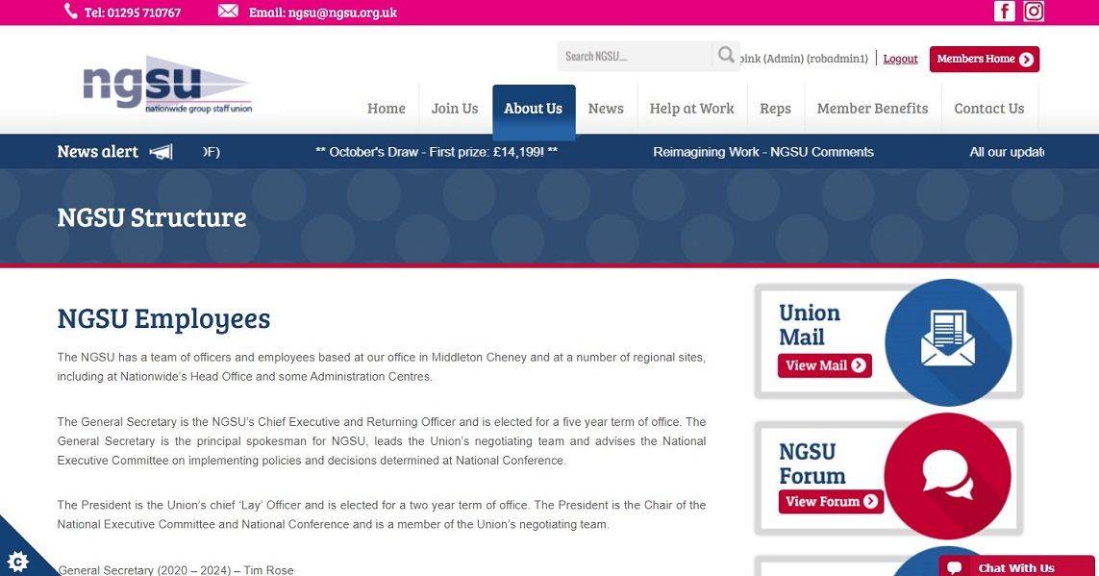
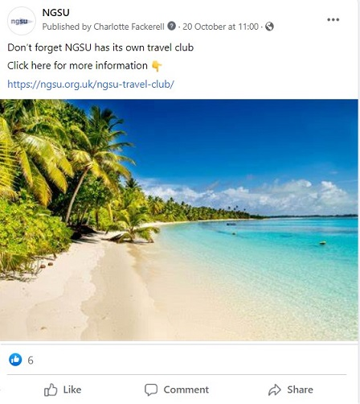
Find Out More
Our Facebook Page:
Facebook - NationwideGroupStaffUnion
Our Website:
https://ngsu.org.uk/

Slide 19
In Summary

Slide 20
Don’t wait until you need advice or help – join today to get the full benefit of Union membership right away!

